Slide 1
Lecture #8: Decision Trees and Random Forests

Slide 2
ANNOUNCEMENTS
HW3 grades will be released tomorrow.
HW4 is due tomorrow night at 11:59pm
Please see the Ed Announcement regarding errata and clarifications.
HW5 (our last HW) will be posted tomorrow night, and due 7/28. It will be shorter.
The Final Exam (individual work) will be posted July 27 (Monday) and due Monday, Aug. 3. It is cumulative and will be more open-ended.

Slide 3
Outline
General Review
Review of Ensemble Methods
Boosting
Set-up and intuition
Connection to Gradient Descent
The Algorithm
Stacking

Slide 4
Uncertainty in model estimates and prediction
Cross validation
Overfitting: Variance & Bias
Pandas
NumPy
Scikit-Learn
PCA & dimensionality reduction
Matplotlib
Statistical Learning
Computing Tools
Methods of regularization:
Lasso and Ridge
Stats Models
Regression
Classification
Logistic
Linear
KNN
Decision Trees
Ensemble Methods: Forests, Boosting, Stacking
Neural Networks
Experimental Design & Causal Inference

Slide 5
Lectures 1 & 2: Data
We started the class with basic data analysis and got experience with the tools within Python to do data acquisition, and EDA:
Tools: numpy, pandas, matplotlib, beautifulsoup
We learned basic exploratory data analysis (EDA) approaches:
Summaries: basic statistics, tables, group comparisons
Visuals: histograms, boxplots, barplots; scatterplots, side-by-side boxplots, stacked and side-by-side barplots
The keys to decide what summaries to look at were 2 fold:
1. What type of variable is the response variable (quantitative vs. categorical)?
2. What comparisons and associations do we want to inspect? Or just explore the distribution.
We also first saw the data science process…

Slide 6
What?
The Data Science Process
Ask an interesting question
Get the Data
Explore the Data
Model the Data
Communicate/Visualize the Results

Slide 7
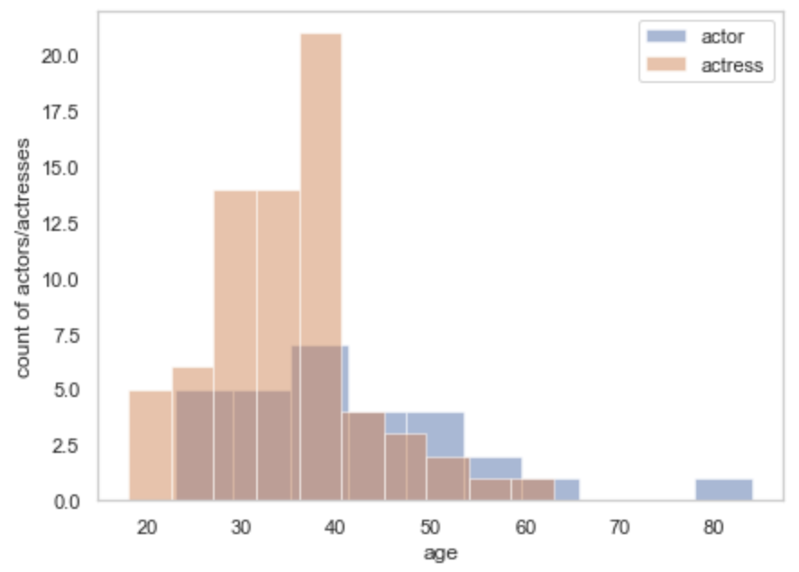
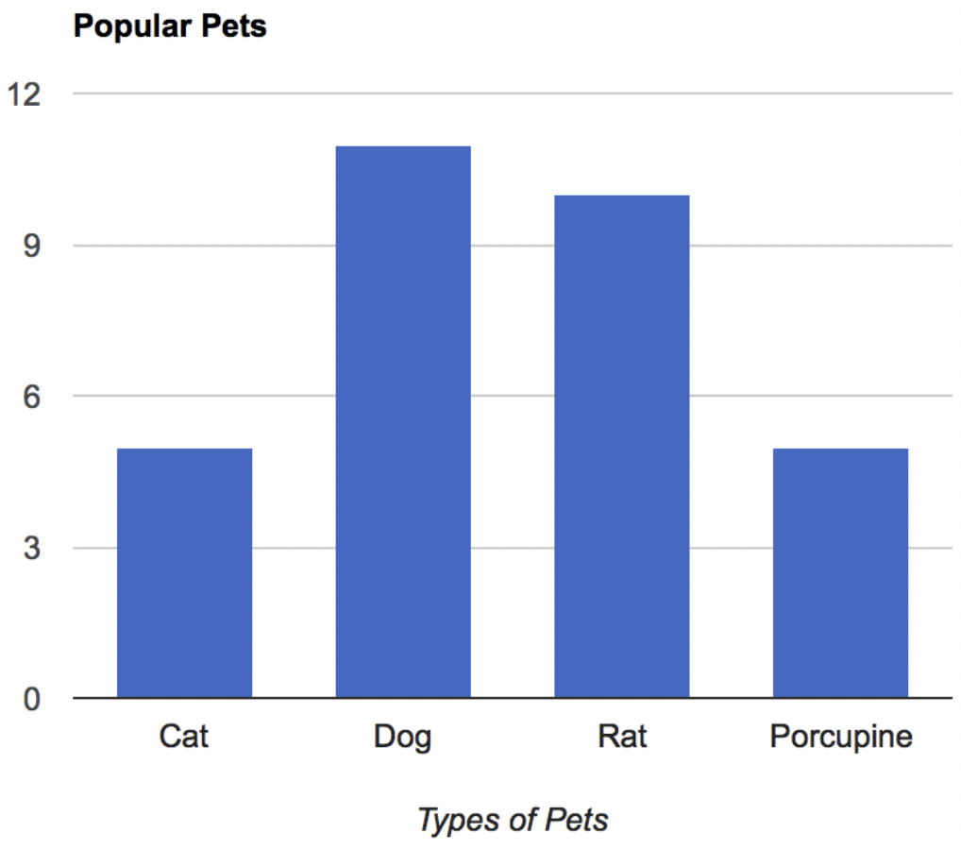
Lectures 1 & 2: Concept Checks
When is the median preferred to be used over the mean? Why?
What is an outlier? How can they be detected?
Describe these distributions:

Slide 8
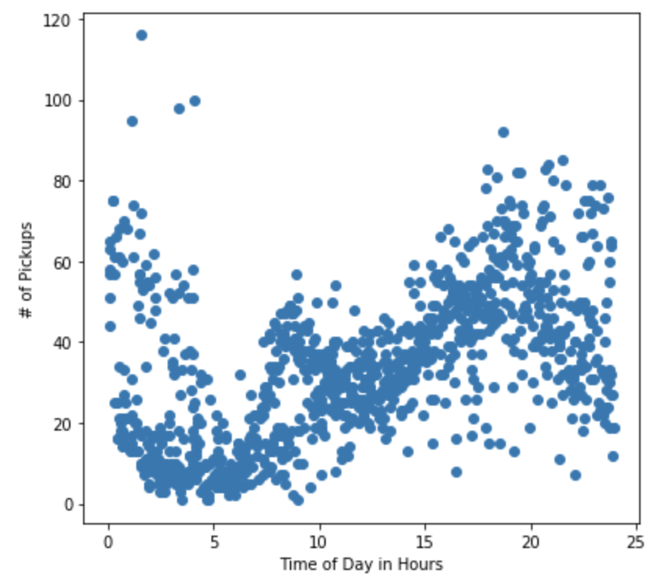
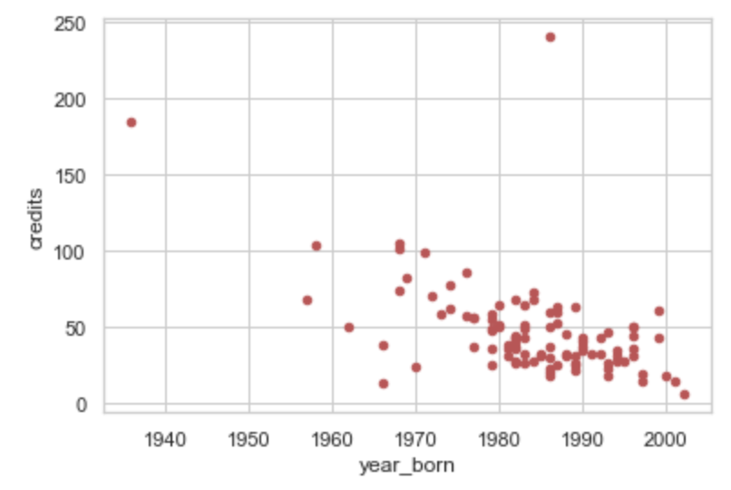
Lectures 1 & 2: Concept Checks (cont.)
Describe these relationships:

Slide 9

Lectures 1 & 2: Concept Check: Adventures in Plotting

Slide 10
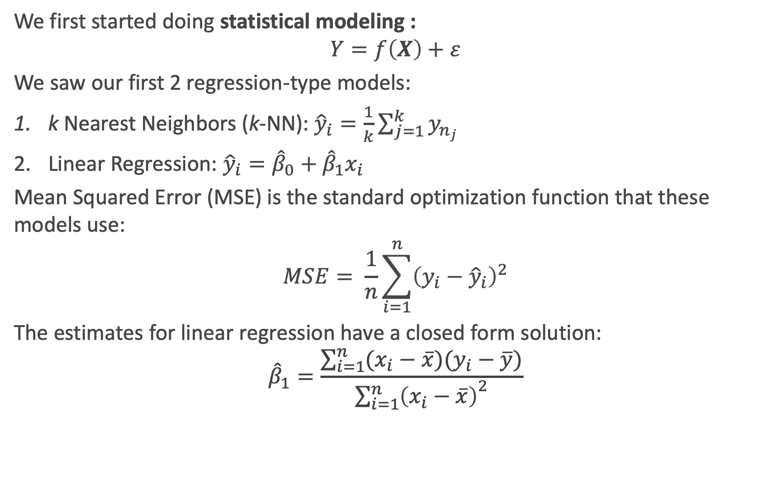
Lecture 3: k-NN and Linear Regression (cont.)
We first started doing statistical modeling :
$$Y=f\left(X\right)+ε$$
We saw our first 2 regression-type models:
k Nearest Neighbors (k-NN): ${\hat{y}}_{i}=\frac{1}{k}\sum_{j=1}^{k}{y_{n_{j}}}$
Linear Regression: ${\hat{y}}_{i}={\hat{β}}_{0}+{\hat{β}}_{1}x_{i}$
Mean Squared Error (MSE) is the standard optimization function that these models use:
$$MSE= \frac{1}{n}\sum_{i=1}^{n}{{\left(y_{i}−{\hat{y}}_{i}\right)}^{2}}$$
The estimates for linear regression have a closed form solution:
$${\hat{β}}_{1}=\frac{\sum_{i=1}^{n}{(x_{i}−\overline{x})(y_{i}−\overline{y})}}{{\sum_{i=1}^{n}{\left(x_{i}−\overline{x}\right)}}^{2}}$$

Slide 11
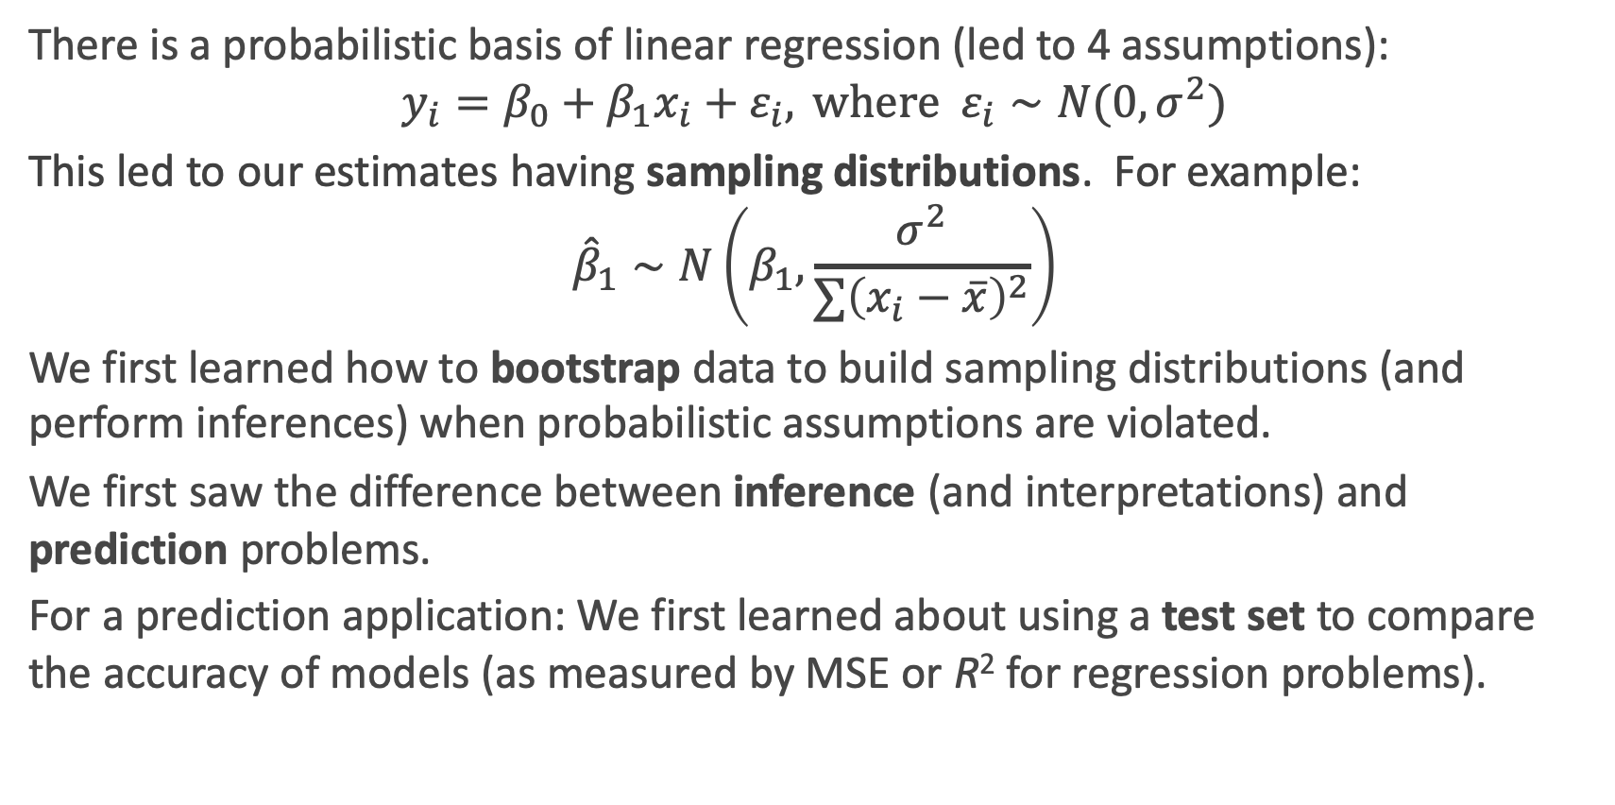
Lecture 3: k-NN and Linear Regression
There is a probabilistic basis of linear regression (led to 4 assumptions):
$$y_{i}=β_{0}+β_{1}x_{i}+ε_{i}, \text{where} ε_{i}∼N(0,σ^{2})$$
This led to our estimates having sampling distributions. For example:
$${\hat{β}}_{1}∼N\left(β_{1},\frac{σ^{2}}{∑{\left(x_{i}−\overline{x}\right)}^{2}}\right)$$
We first learned how to bootstrap data to build sampling distributions (and perform inferences) when probabilistic assumptions are violated.
We first saw the difference between inference (and interpretations) and prediction problems.
For a prediction application: We first learned about using a test set to compare the accuracy of models (as measured by MSE or R² for regression problems).

Slide 12
Lecture 3: Concept Checks
Which is a parametric model? Which is a non-parametric model? Why? What does it mean to be non-parametric vs. parametric?
How are neighbors chosen in k-NN? How are predictions made? How can this model be interpreted? What happens when k = 1? When k = n?
Why is it called ordinary least squares (OLS) regression?
What happens when the assumptions to linear regression are violated?
How can bootstrapping be used to calculate confidence intervals?

Slide 13
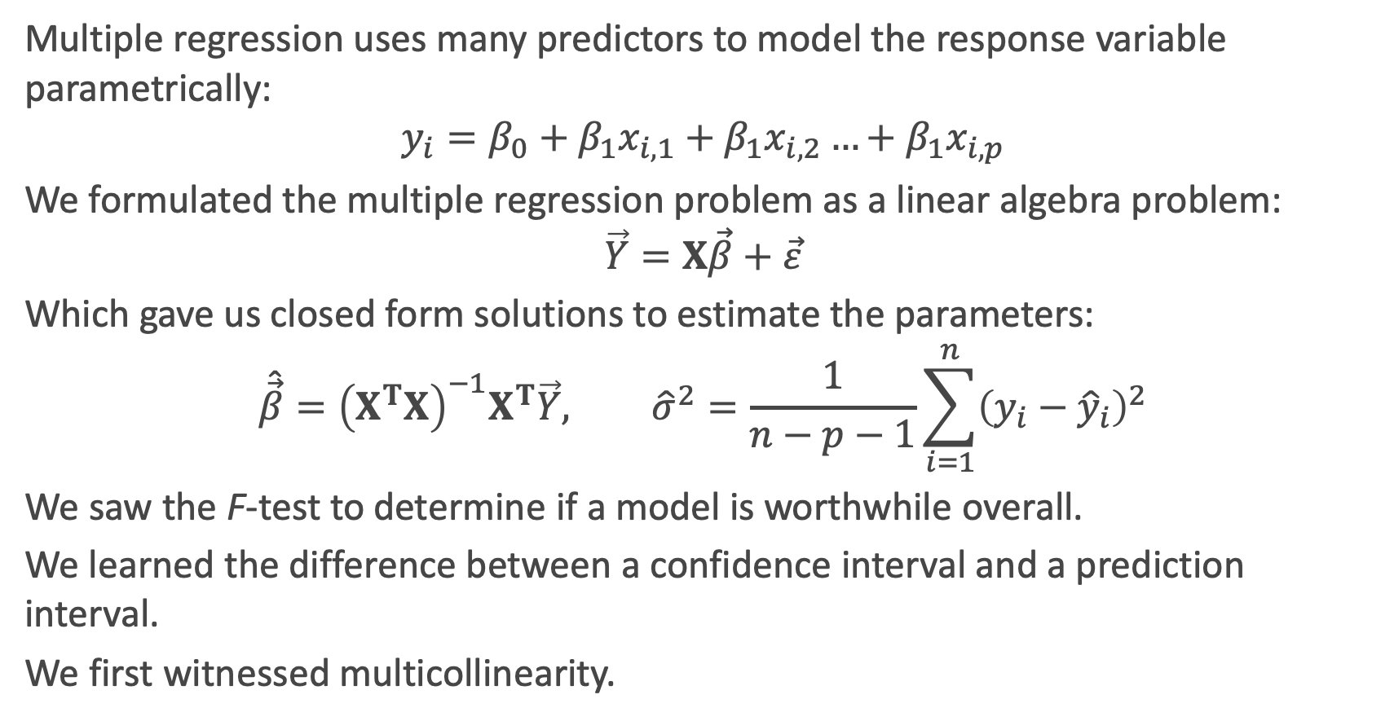
Lecture 4: Multiple Regression
Multiple regression uses many predictors to model the response variable parametrically:
$$y_{i}=β_{0}+β_{1}x_{i,1}+β_{1}x_{i,2}…+β_{1}x_{i,p}$$
We formulated the multiple regression problem as a linear algebra problem:
$$\vec{Y}=X\vec{β}+\vec{ε}$$
Which gave us closed form solutions to estimate the parameters:
$$\hat{\vec{β}}={\left(X^{T}X\right)}^{−1}X^{T}\vec{Y}, {\hat{σ}}^{2}=\frac{1}{n−p−1}\sum_{i=1}^{n}{{\left(y_{i}−{\hat{y}}_{i}\right)}^{2}}$$
We saw the F-test to determine if a model is worthwhile overall.
We learned the difference between a confidence interval and a prediction interval.
We first witnessed multicollinearity.

Slide 14
Lecture 4: Multiple Regression (cont.)
We parameterized the models with various types of predictors:
binary indicators
polynomial functions
interaction terms
We observed the models with lots of predictors (complex models) lead to overfitting.
We first learned the variance-bias trade-off when fitting models.
We learned one way to prevent overfitting is by using variable selection.

Slide 15
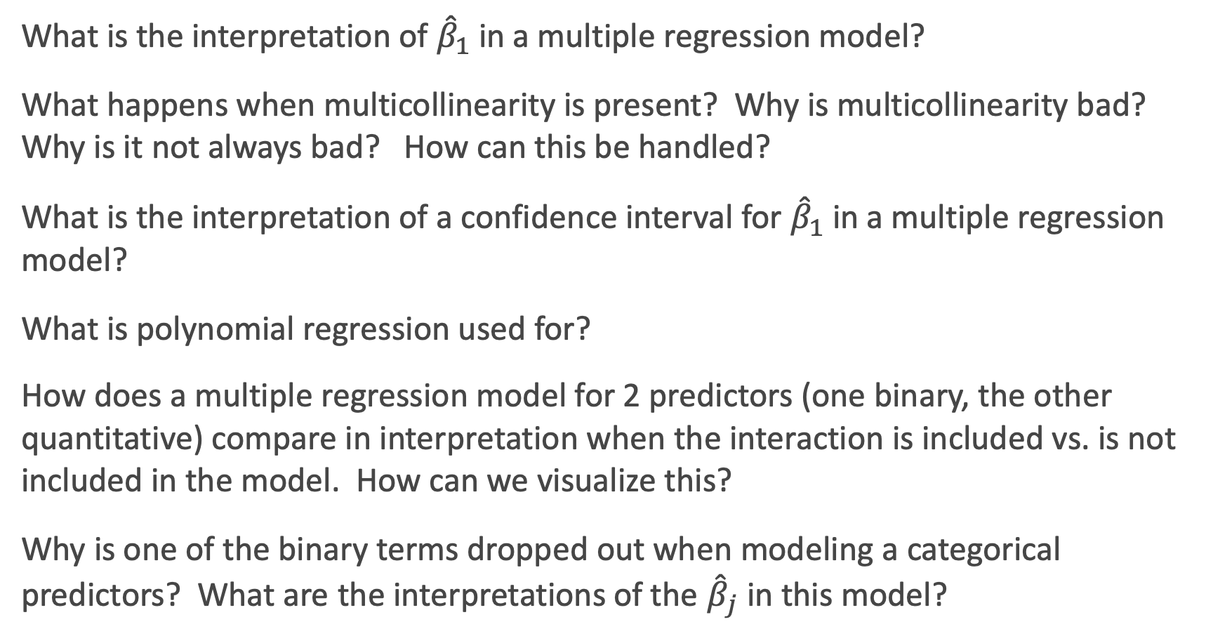
Lecture 4: Concept Checks
What is the interpretation of ${\hat{β}}_{1}$ in a multiple regression model?
What happens when multicollinearity is present? Why is multicollinearity bad? Why is it not always bad? How can this be handled?
What is the interpretation of a confidence interval for ${\hat{β}}_{1}$ in a multiple regression model?
What is polynomial regression used for?
How does a multiple regression model for 2 predictors (one binary, the other quantitative) compare in interpretation when the interaction is included vs. is not included in the model. How can we visualize this?
Why is one of the binary terms dropped out when modeling a categorical predictors? What are the interpretations of the ${\hat{β}}_{j}$ in this model?

Slide 16
Lecture 4: Concept Checks (cont.)
When is an F-test useful?
What should be used as a metric when comparing models (in variable selection, for example)?
Interpret these residual plots: What does this plot show?

Slide 17
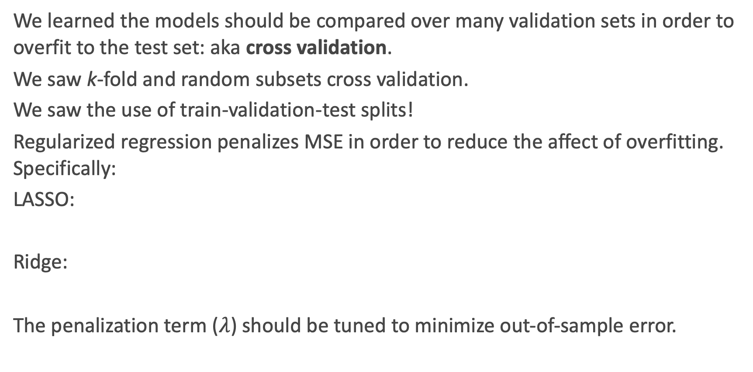
Lecture 5: Cross-Validation and Regularization
We learned the models should be compared over many validation sets in order to overfit to the test set: aka cross validation.
We saw k-fold and random subsets cross validation.
We saw the use of train-validation-test splits!
Regularized regression penalizes MSE in order to reduce the affect of overfitting. Specifically:
LASSO:
Ridge:
The penalization term ($λ$) should be tuned to minimize out-of-sample error.

Slide 18
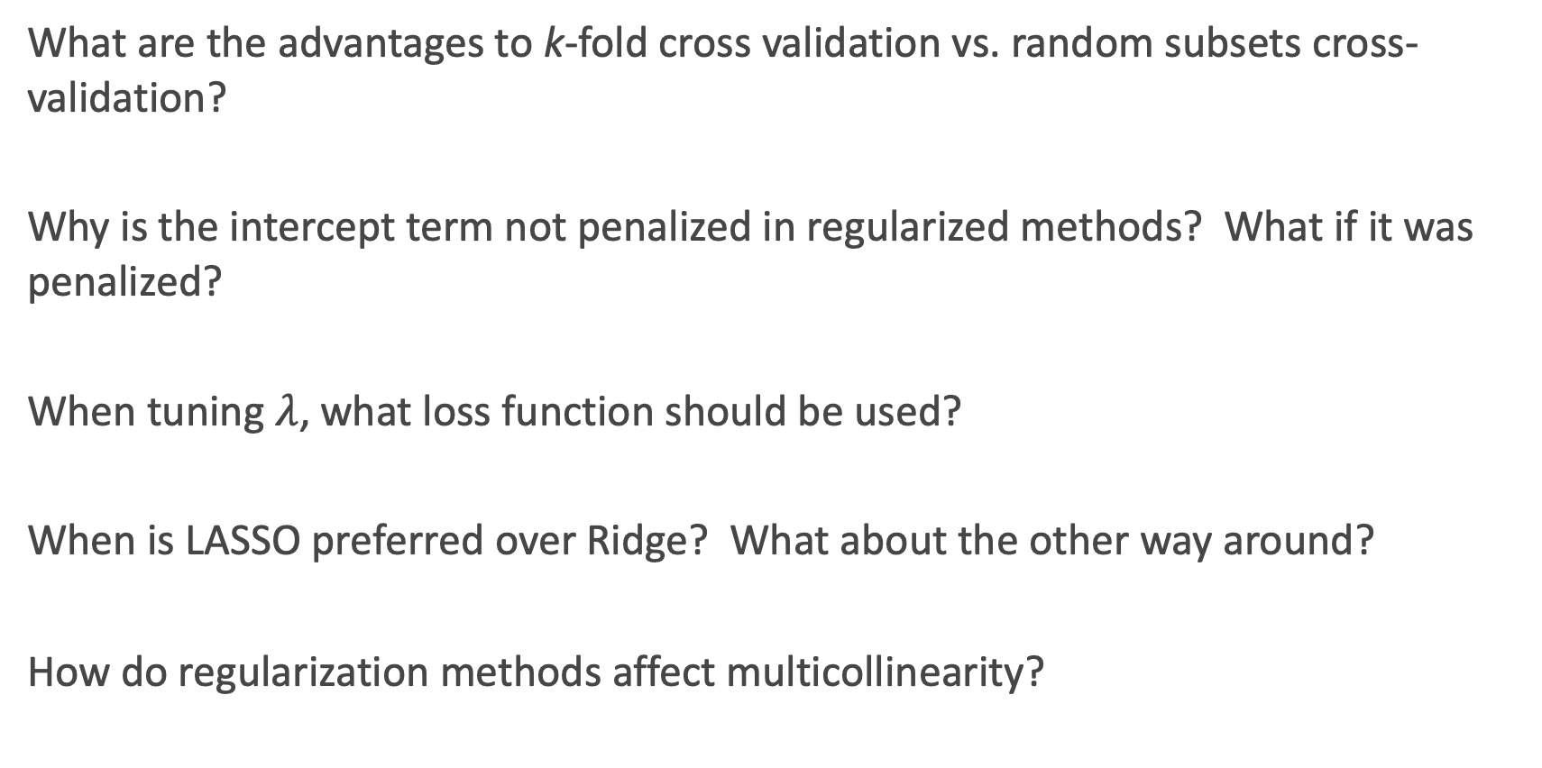
Lecture 5: Concept Checks
What are the advantages to k-fold cross validation vs. random subsets cross-validation?
Why is the intercept term not penalized in regularized methods? What if it was penalized?
When tuning $λ$, what loss function should be used?
When is LASSO preferred over Ridge? What about the other way around?
How do regularization methods affect multicollinearity?

Slide 19
Lecture 5: Concept Checks (cont.)
What is interesting about these plots? What do they illustrate?

Slide 20
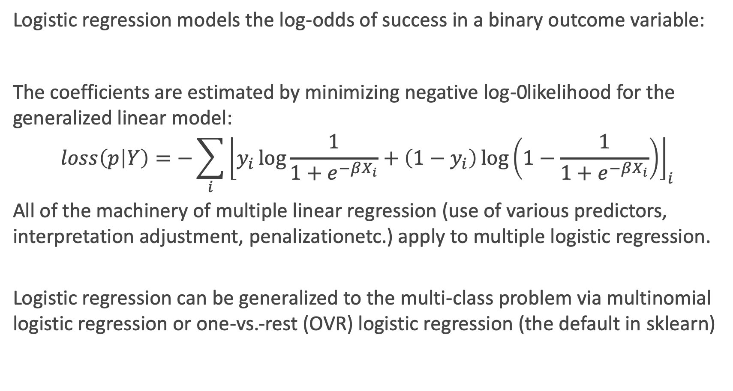
Lecture 6: Classification and Logistic Regression
Logistic regression models the log-odds of success in a binary outcome variable:
The coefficients are estimated by minimizing negative log-0likelihood for the generalized linear model:
$$loss\left(p | Y\right)=−\sum_{i}{{\left\lfloor y_{i}\log{\frac{1}{1+e^{−βX_{i}}}+\left(1−y_{i}\right)\log\left(1−\frac{1}{1+e^{−βX_{i}}}\right)}\right\rfloor }_{i} }$$
All of the machinery of multiple linear regression (use of various predictors, interpretation adjustment, penalizationetc.) apply to multiple logistic regression.
Logistic regression can be generalized to the multi-class problem via multinomial logistic regression or one-vs.-rest (OVR) logistic regression (the default in sklearn)

Slide 21
Lecture 6: Classification and Logistic Regression (cont.)
A logistic regression’s predictions are typically turned into classifications by choosing the Bayes’ classifier to minimize misclassification error rate. This leads to a linear classification boundary.
Confusion Matrices can be used for many classification thresholds, and positive predictive values (PPV) and NPV rates can be calculated from them.
An ROC curve depicts all of these combinations of NPV and PPV, and can be summarized via the area under the curve metric (AUC).
There are many metrics to use for determining accuracy of classification models (AUC, PPV, NPV, for examples).

Slide 22
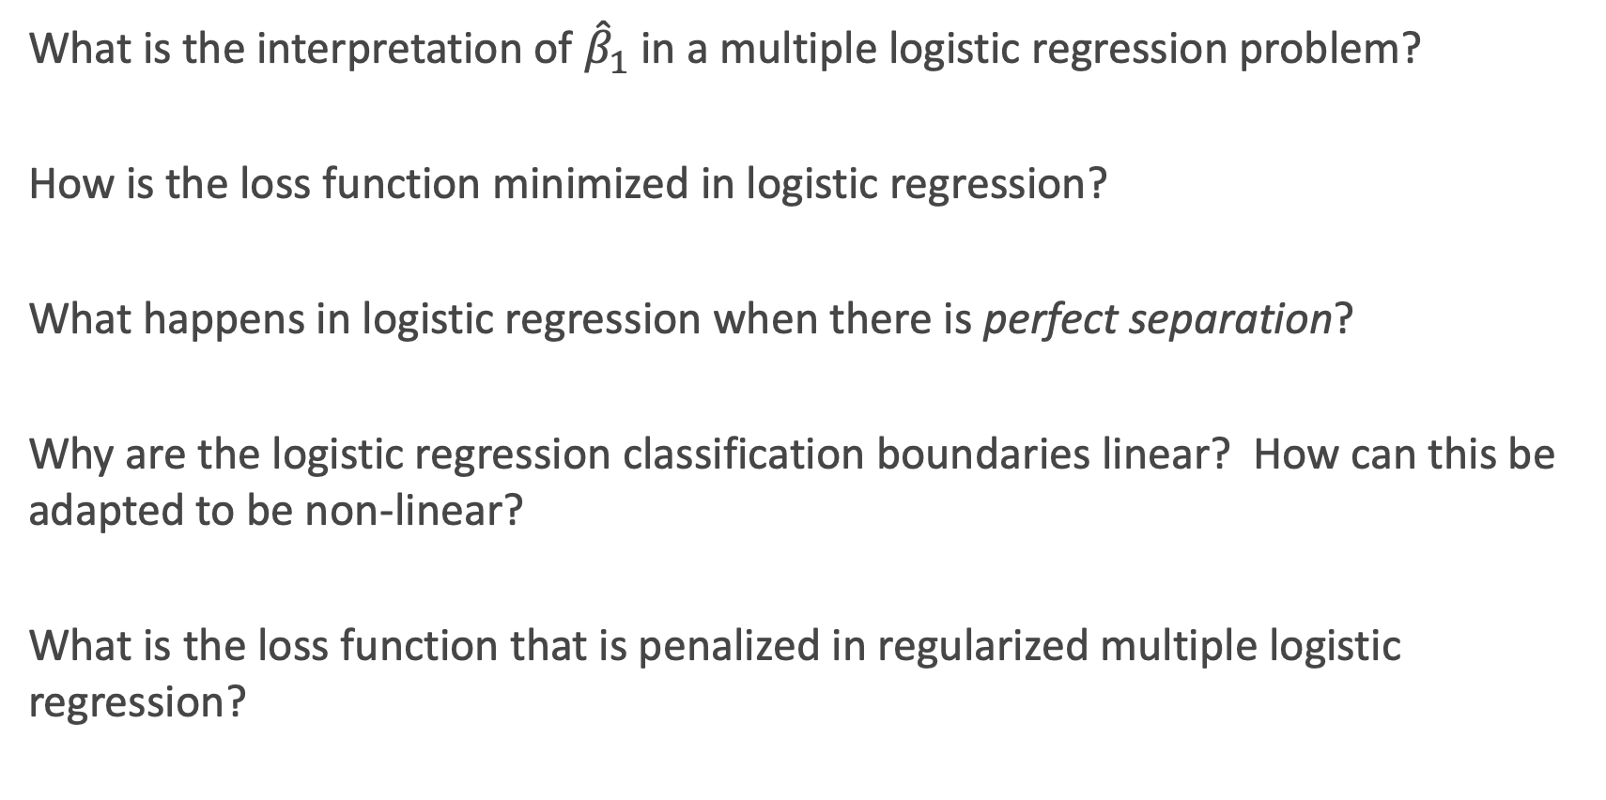
Lecture 6: Concept Checks
What is the interpretation of ${\hat{β}}_{1}$in a multiple logistic regression problem?
How is the loss function minimized in logistic regression?
What happens in logistic regression when there is perfect separation?
Why are the logistic regression classification boundaries linear? How can this be adapted to be non-linear?
What is the loss function that is penalized in regularized multiple logistic regression?

Slide 23
Lecture 7: k-NN Classification and PCA
The method of k-NN can be adapted to a classification problem: the nearest neighbors are calculated the same way as a regression problem, but the predictions are just relative frequency of classes within the neighborhood.
k-NN classification boundaries are very flexible, but need to be tuned to prevent overfitting.
High Dimensionality (a lot of predictors) leads to numerical and estimation issues (unidentifiability, difficulty in interpretation, and overfitting.
Principal Components Analysis (PCA) is a method to handle high dimensionality in the predictors. It is an unsupervised method.
In PCA, a set of new predictors (the components) is created that is an ordered list of representative variables based on the explained variability in the predictor set.
It is VERY important to standardize your predictors before performing PCA.

Slide 24
Lecture 7: Concept Checks
Should predictors be standardized in k-NN? How can categorical predictors be handled?
How can probability predictions be made in k-NN classification?
When is PCA used most commonly in practice?
Is the first PCA component going to be the best predictor in a PCR regression? Why?
How many PCA components should be used in a PCR egression?
How can the coefficient estimates be interpreted in a regression fit on PCA component vectors?

Slide 25
Lecture 8: Trees and Forests
Decision trees (both regression and classification) are calculated by finding the splits in the predictor set (one at a time) that best improve some optimization metric (MSE for regression, Gini or Entropy for classification). This leads to a step-like function in the prediction scatterplots or classification boundaries.
Overfitting can be prevented by either some stopping criterion or by pruning an overfit tree
Ensemble methods (combining the predictions of many base models) can be used to improve prediction accuracy of models. This makes the interpretation difficult.
Bootstrap-Aggregating (Bagging) is the first ensemble method we have seen. It improves the prediction of by averaging the predictions of many base tree models. Each base model is estimated based on a random bootstrapped subset of observations.

Slide 26
Lecture 8: Trees and Forests (cont.)
Random Forests adds an extra layer of random sampling (a subset of the variables at each split) to de-correlate the base tree models.
There are 3 parameters to tune in a random forest: complexity (depth measured in some way), number of predictors sampled at each split, and number of trees.
Out-of-bag sample can be used to estimate out-of-sample error, and thus can be used to tune any hyperparameters.
Feature importance can be measured to help interpret a tree-based model. This measures the contributed improvement in MSE (or Gini/Entropy)

Slide 27
Lecture 8: Concept Checks
Why should categorical predictors not be turned into binary indicator variables in a tree-based model?
Should predictors be standardized in a tree-based model? Should they be log-transformed? What about the response variable? How are interactions handled?
How can relationship between a predictor with the response be determined in a tree-based model? What values for the other predictors should be used when doing this?
How is bagging a special case of random forests?
Why do bagging and random forests improve the variance of the overly complex based models?
Which parameters really need to be tuned in a random forest?

Slide 28
Review of Ensemble Methods (Bagging and Random Forests)

Slide 29
Bags and Forests of Trees
Last time we examined how the short-comings of single decision tree models can be overcome by ensemble methods - making one model out of many trees.
We focused on the problem of training large trees, these models have low bias but high variance.
We compensated by training an ensemble of full decision trees and then averaging their predictions - thereby reducing the variance of our final model.

Slide 30
Bags and Forests of Trees (cont.)
Bagging:
create an ensemble of full trees, each trained on a bootstrap sample of the training set;
average the predictions
Random forest:
create an ensemble of full trees, each trained on a bootstrap sample of the training set;
in each tree and each split, randomly select a subset of predictors, choose a predictor from this subset for splitting;
average the predictions
Note that the ensemble building aspects of both method are embarrassingly parallel!

Slide 31
Motivation for Boosting
Could we address the shortcomings of single decision trees models in some other way?
For example, rather than performing variance reduction on complex trees, can we decrease the bias of simple trees - make them more expressive?
A solution to this problem, making an expressive model from simple trees, is another class of ensemble methods called boosting.

Slide 32
Boosting Algorithms

Slide 33
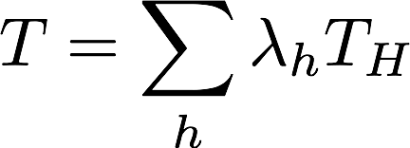
Gradient Boosting
The key intuition behind boosting is that one can take an ensemble of simple models {T_{h}}_{h∈H} and additively combine them into a single, more complex model.
Each model T_{h} might be a poor fit for the data, but a linear combination of the ensemble
can be expressive/flexible.
But which models should we include in our ensemble? What should the coefficients or weights in the linear combination be?

Slide 34
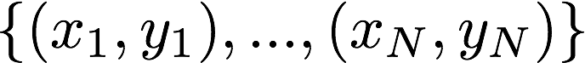
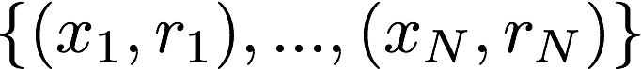
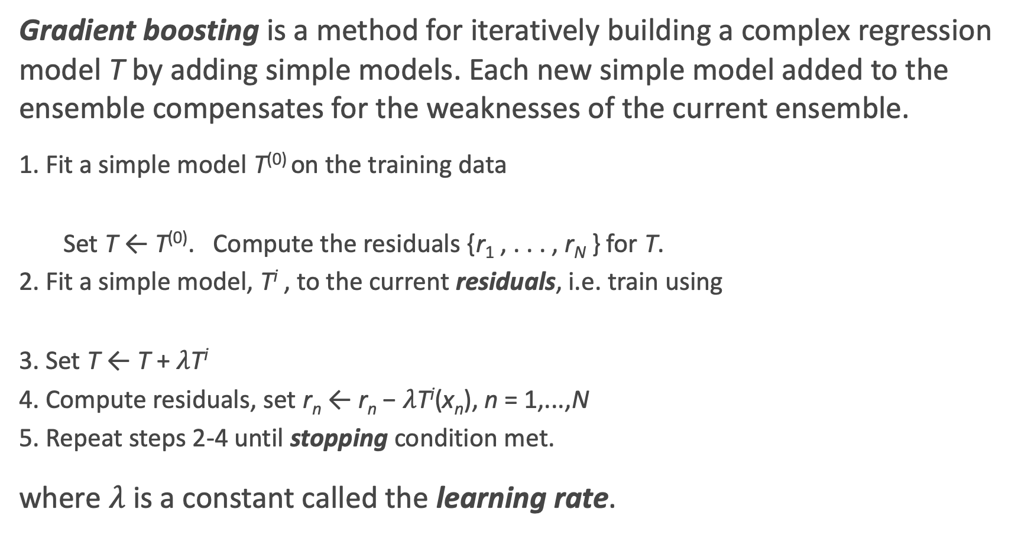
Gradient Boosting: the algorithm
Gradient boosting is a method for iteratively building a complex regression model T by adding simple models. Each new simple model added to the ensemble compensates for the weaknesses of the current ensemble.
1. Fit a simple model T⁽⁰⁾ on the training data
Set T ← T⁽⁰⁾. Compute the residuals {r₁ , . . . , r_{N} } for T.
2. Fit a simple model, T^{i} , to the current residuals, i.e. train using
3. Set T ← T + $λ$T^{i}
4. Compute residuals, set r_{n} ← r_{n} − $λ$T^{i}(x_{n}), n = 1,...,N
5. Repeat steps 2-4 until stopping condition met.
where $λ$ is a constant called the learning rate.

Slide 35
Gradient Boosting: illustration (0)

Slide 36
Gradient Boosting: illustration 1

Slide 37
Gradient Boosting: illustration 2

Slide 38
Gradient Boosting: illustration 3

Slide 39
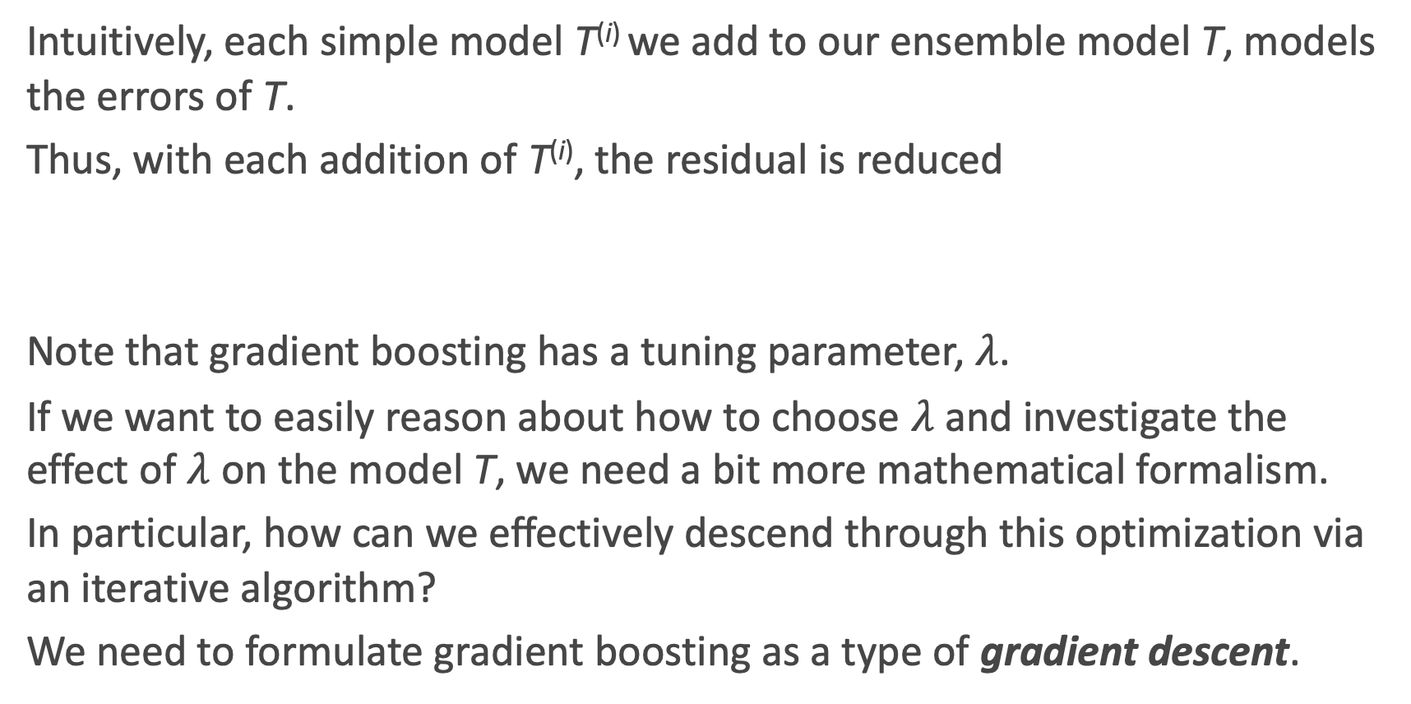
Why Does Gradient Boosting Work?
Intuitively, each simple model T^{(i)} we add to our ensemble model T, models the errors of T.
Thus, with each addition of T^{(i)}, the residual is reduced
Note that gradient boosting has a tuning parameter, $λ$.
If we want to easily reason about how to choose $λ$ and investigate the effect of $λ$ on the model T, we need a bit more mathematical formalism.
In particular, how can we effectively descend through this optimization via an iterative algorithm?
We need to formulate gradient boosting as a type of gradient descent.

Slide 40
Review: A Brief Sketch of Gradient Descent
In optimization, when we wish to minimize a function, called the objective function, over a set of variables, we compute the partial derivatives of this function with respect to the variables.
If the partial derivatives are sufficiently simple, one can analytically find a common root - i.e. a point at which all the partial derivatives vanish; this is called a stationary point.
If the objective function has the property of being convex, then the stationary point is precisely the min.

Slide 41
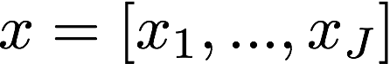
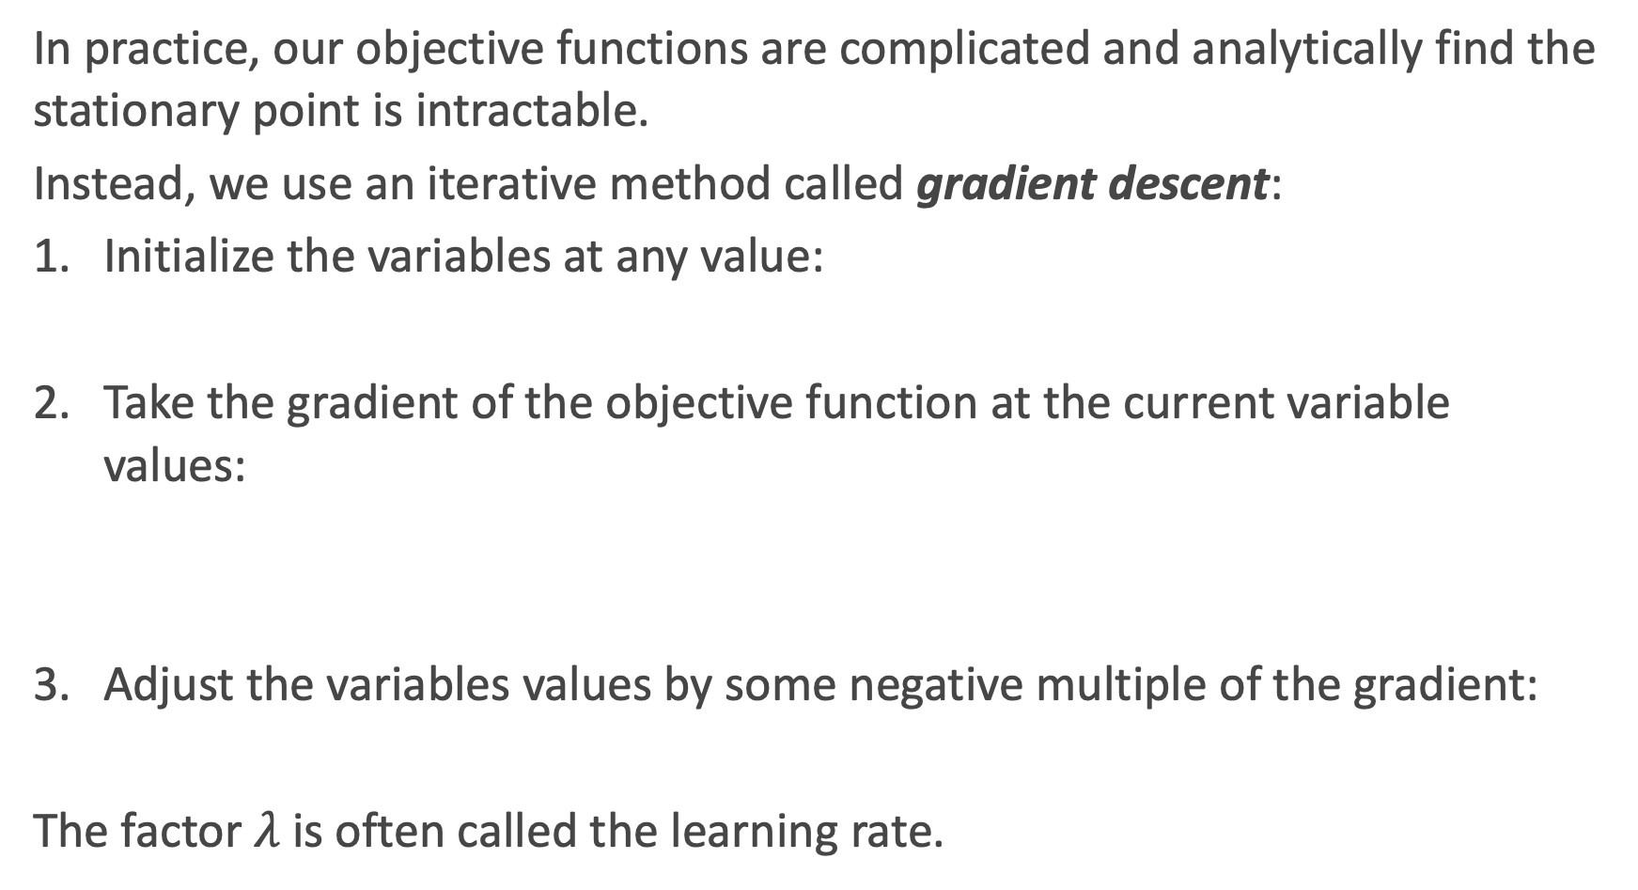
Review: A Brief Sketch of Gradient Descent the Algorithm
In practice, our objective functions are complicated and analytically find the stationary point is intractable.
Instead, we use an iterative method called gradient descent:
Initialize the variables at any value:
Take the gradient of the objective function at the current variable values:
Adjust the variables values by some negative multiple of the gradient:
The factor $λ$ is often called the learning rate.

Slide 42
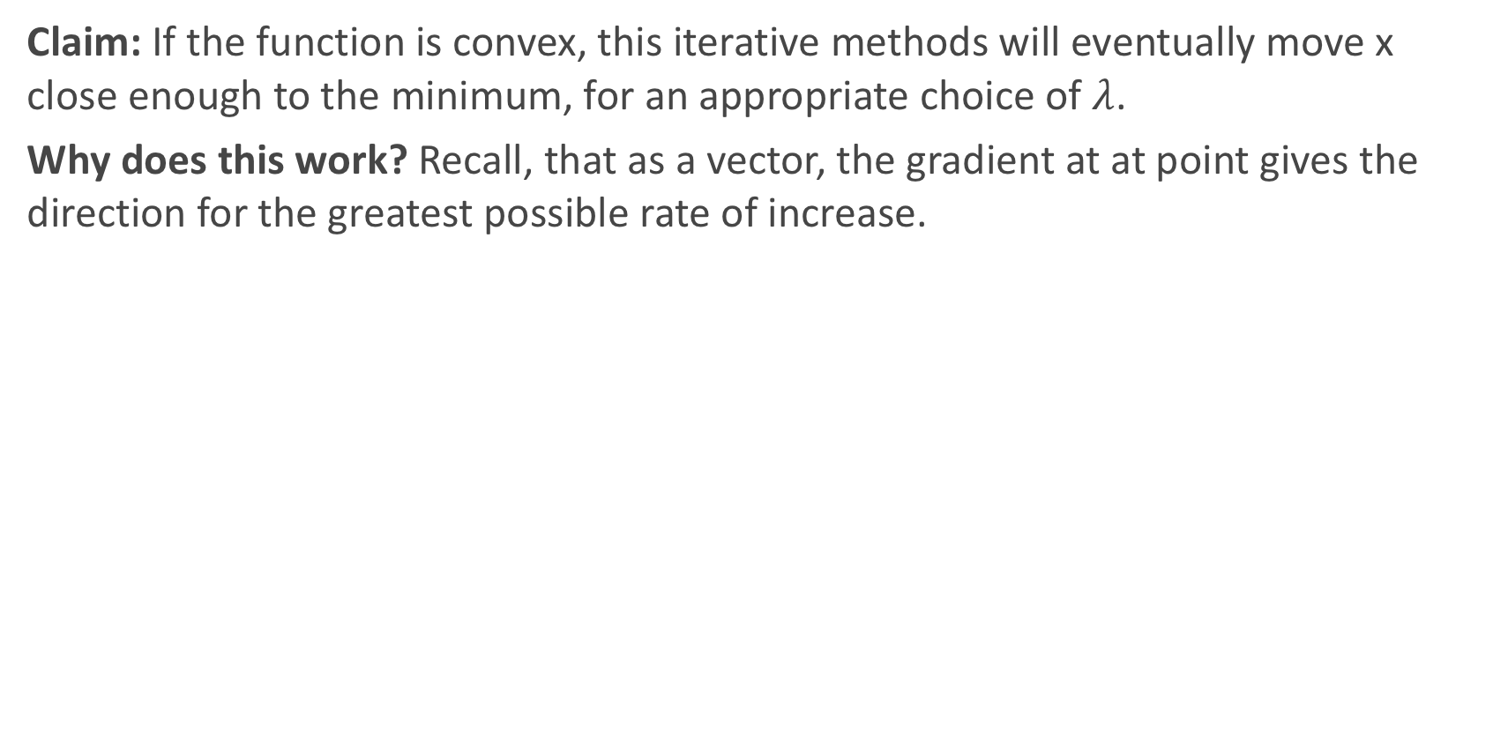
Why Does Gradient Descent Work?
Claim: If the function is convex, this iterative methods will eventually move x close enough to the minimum, for an appropriate choice of $λ$.
Why does this work? Recall, that as a vector, the gradient at at point gives the direction for the greatest possible rate of increase.

Slide 43
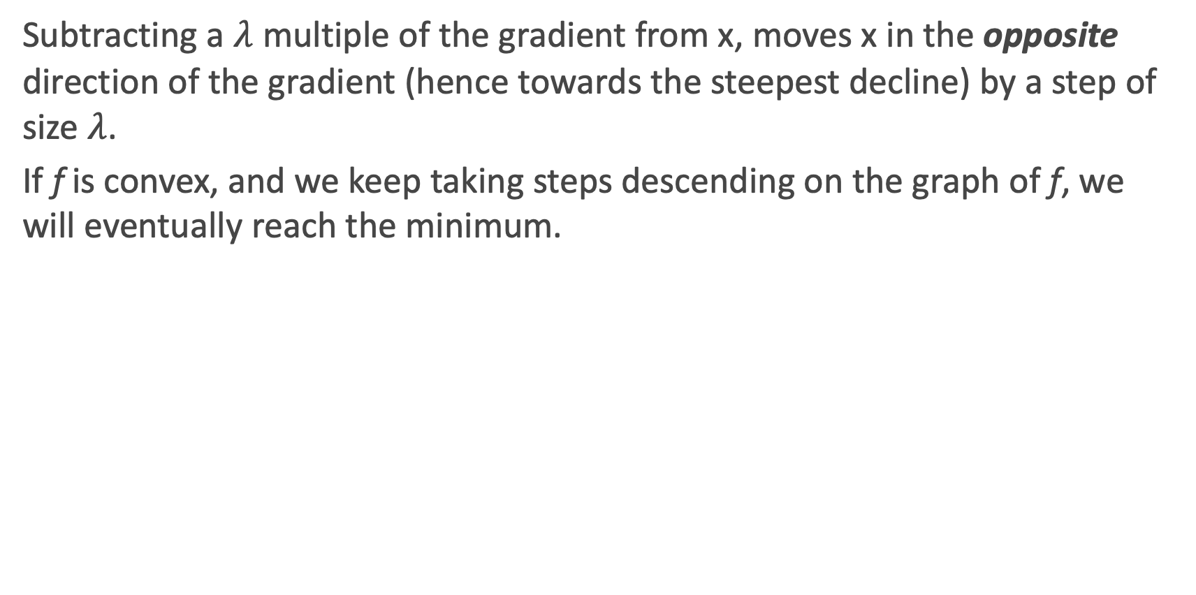
Why Does Gradient Descent Work?
Subtracting a $λ$ multiple of the gradient from x, moves x in the opposite direction of the gradient (hence towards the steepest decline) by a step of size $λ$.
If f is convex, and we keep taking steps descending on the graph of f, we will eventually reach the minimum.

Slide 44
Gradient Boosting as Gradient Descent
Often in regression, our objective is to minimize the MSE
Treating this as an optimization problem, we can try to directly minimize the MSE with respect to the predictions
The update step for gradient descent would look like

Slide 45
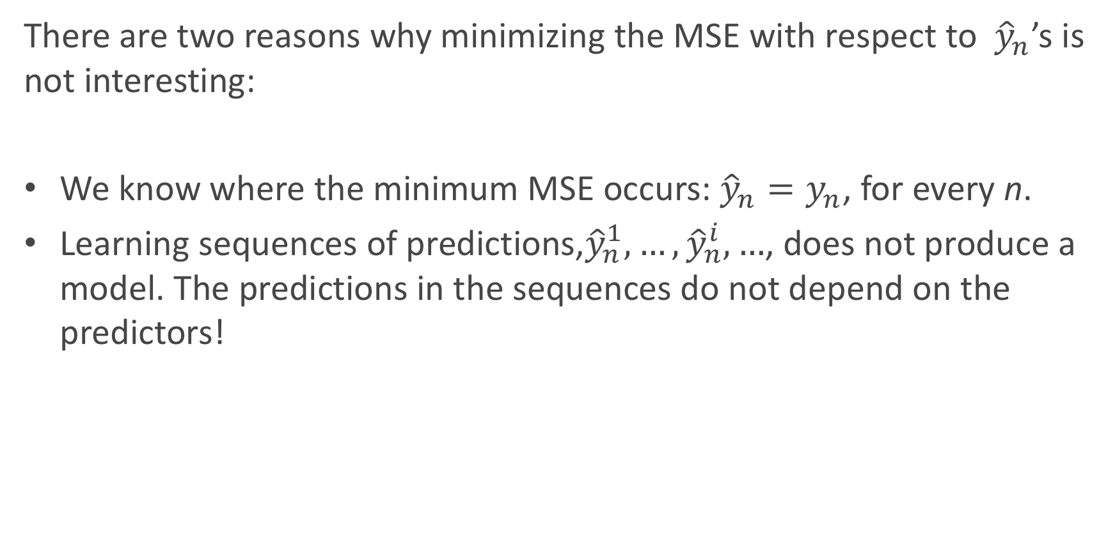
Gradient Boosting as Gradient Descent (cont.)
There are two reasons why minimizing the MSE with respect to ${\hat{y}}_{n}$’s is not interesting:
We know where the minimum MSE occurs: ${\hat{y}}_{n}=y_{n}$, for every n.
Learning sequences of predictions,${\hat{y}}_{n}^{1},…,{\hat{y}}_{n}^{i},…$, does not produce a model. The predictions in the sequences do not depend on the predictors!

Slide 46
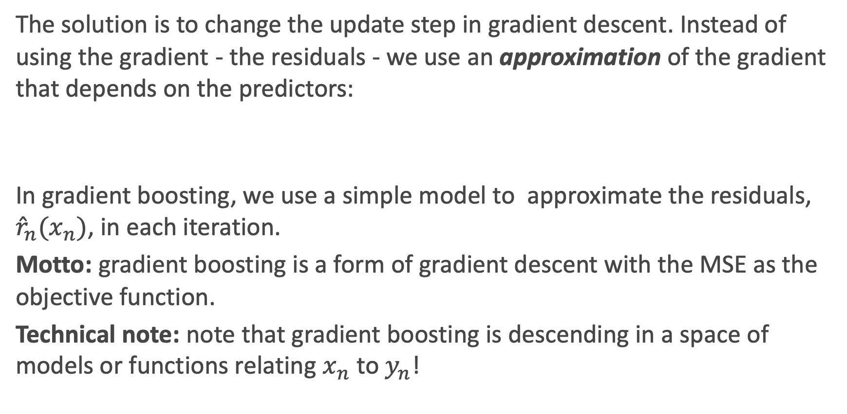
Gradient Boosting as Gradient Descent (cont.)
The solution is to change the update step in gradient descent. Instead of using the gradient - the residuals - we use an approximation of the gradient that depends on the predictors:
In gradient boosting, we use a simple model to approximate the residuals, ${{\hat{r}}_{n}(x}_{n})$, in each iteration.
Motto: gradient boosting is a form of gradient descent with the MSE as the objective function.
Technical note: note that gradient boosting is descending in a space of models or functions relating $x_{n}$ to $y_{n}$!

Slide 47
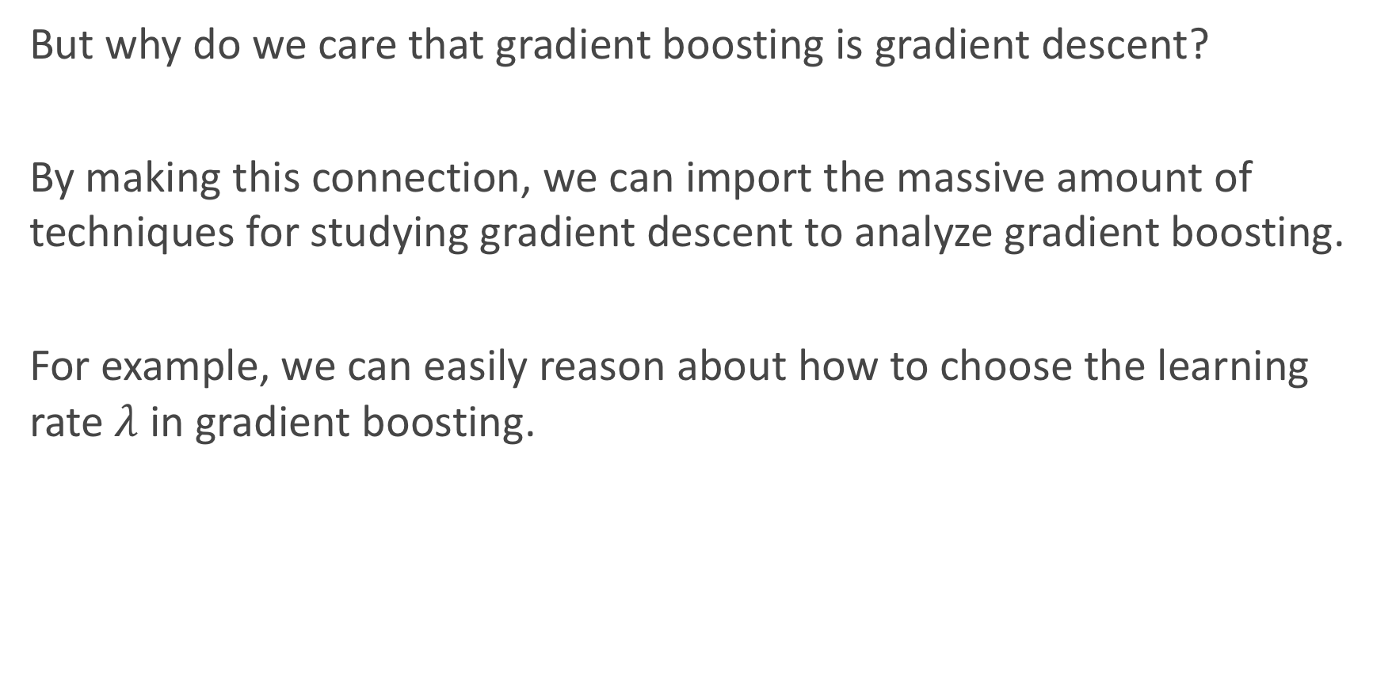
Gradient Boosting as Gradient Descent (cont.)
But why do we care that gradient boosting is gradient descent?
By making this connection, we can import the massive amount of techniques for studying gradient descent to analyze gradient boosting.
For example, we can easily reason about how to choose the learning rate $λ$ in gradient boosting.

Slide 48
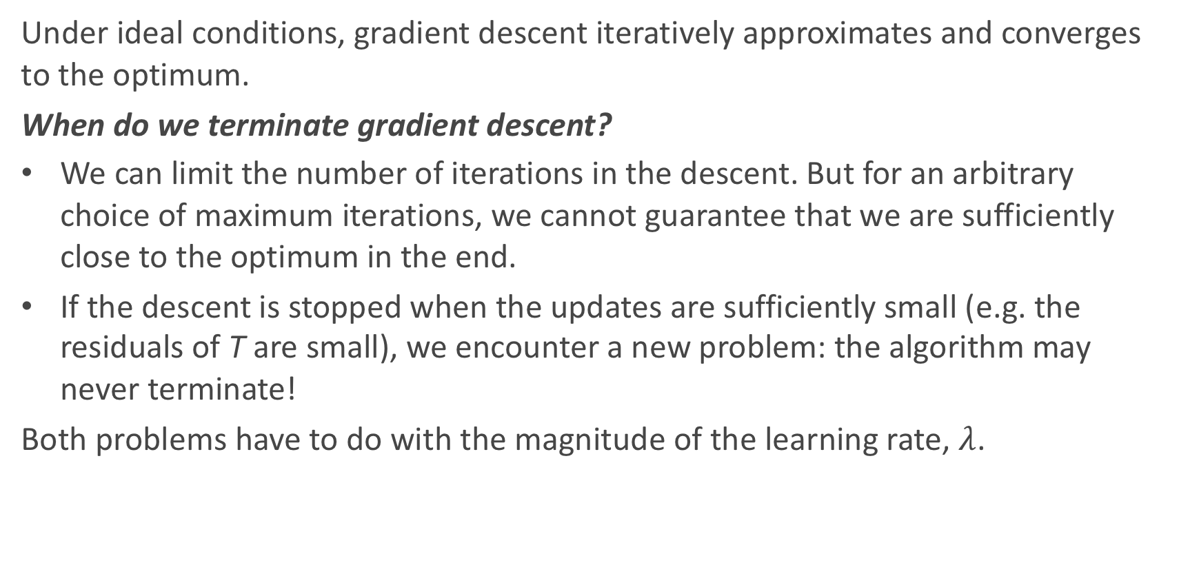
Choosing a Learning Rate
Under ideal conditions, gradient descent iteratively approximates and converges to the optimum.
When do we terminate gradient descent?
We can limit the number of iterations in the descent. But for an arbitrary choice of maximum iterations, we cannot guarantee that we are sufficiently close to the optimum in the end.
If the descent is stopped when the updates are sufficiently small (e.g. the residuals of T are small), we encounter a new problem: the algorithm may never terminate!
Both problems have to do with the magnitude of the learning rate, $λ$.

Slide 49
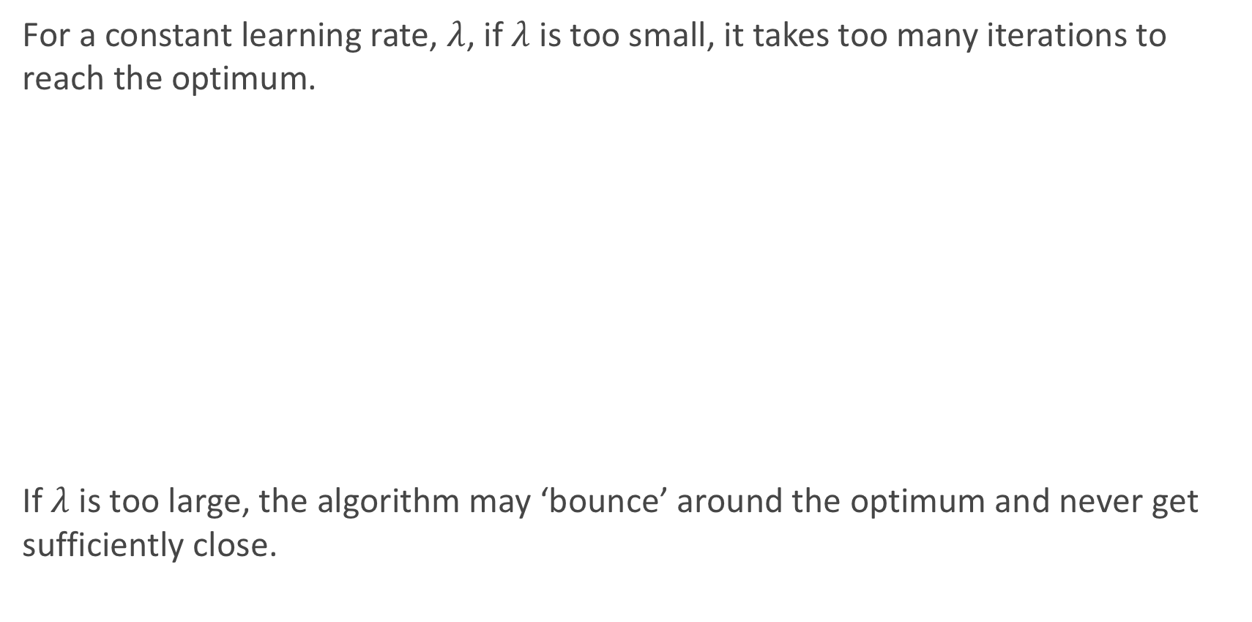
Choosing a Learning Rate
For a constant learning rate, $λ$, if $λ$ is too small, it takes too many iterations to reach the optimum.
If $λ$ is too large, the algorithm may ‘bounce’ around the optimum and never get sufficiently close.

Slide 50
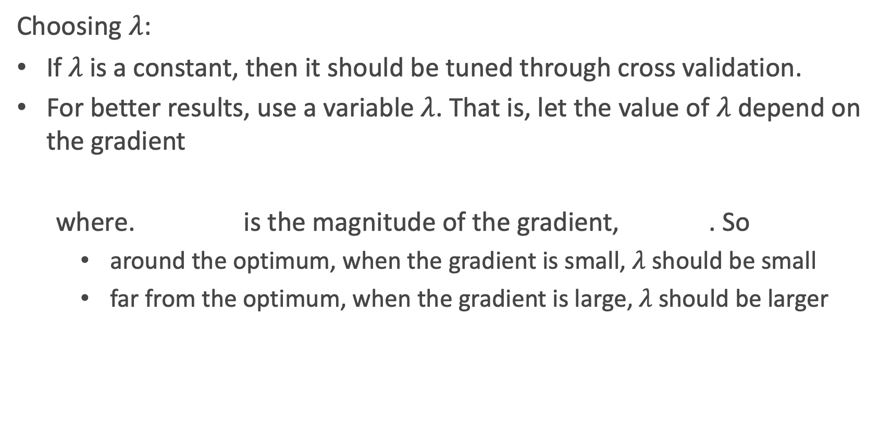
Choosing a Learning Rate
Choosing $λ$:
If $λ$ is a constant, then it should be tuned through cross validation.
For better results, use a variable $λ$. That is, let the value of $λ$ depend on the gradient
where. is the magnitude of the gradient, . So
around the optimum, when the gradient is small, $λ$ should be small
far from the optimum, when the gradient is large, $λ$ should be larger

Slide 51
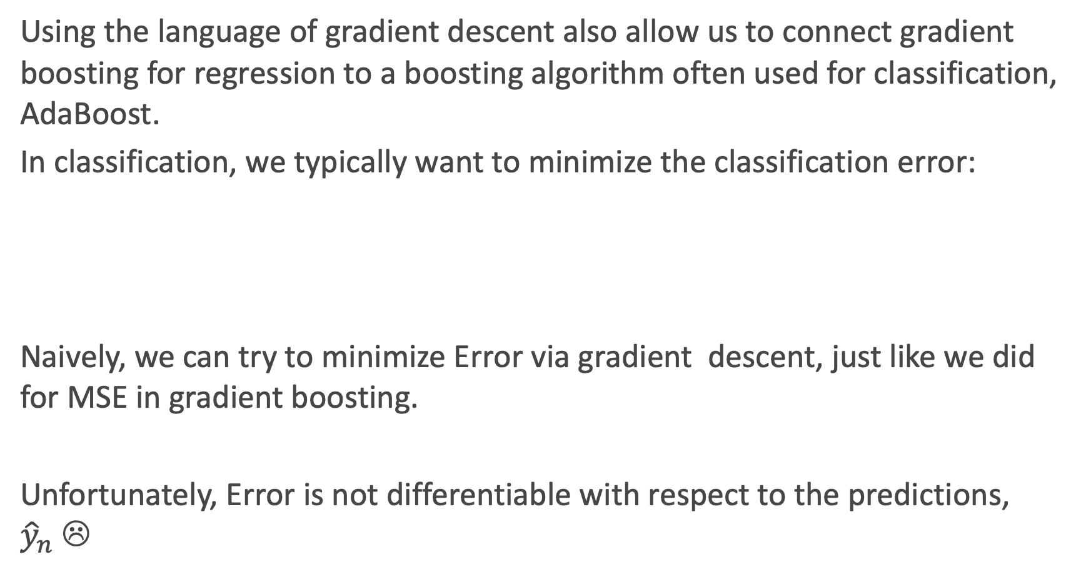
Motivation for AdaBoost
Using the language of gradient descent also allow us to connect gradient boosting for regression to a boosting algorithm often used for classification, AdaBoost.
In classification, we typically want to minimize the classification error:
Naively, we can try to minimize Error via gradient descent, just like we did for MSE in gradient boosting.
Unfortunately, Error is not differentiable with respect to the predictions, ${\hat{y}}_{n}$☹

Slide 52
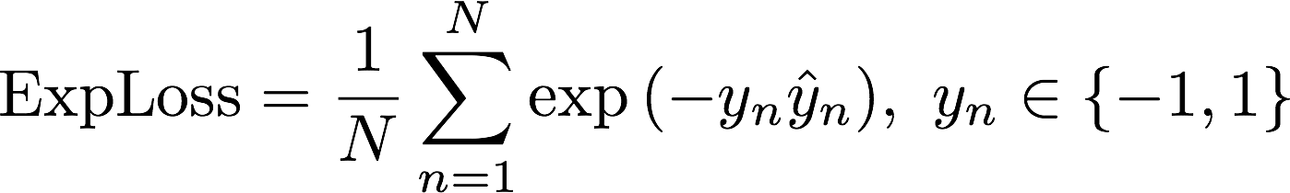
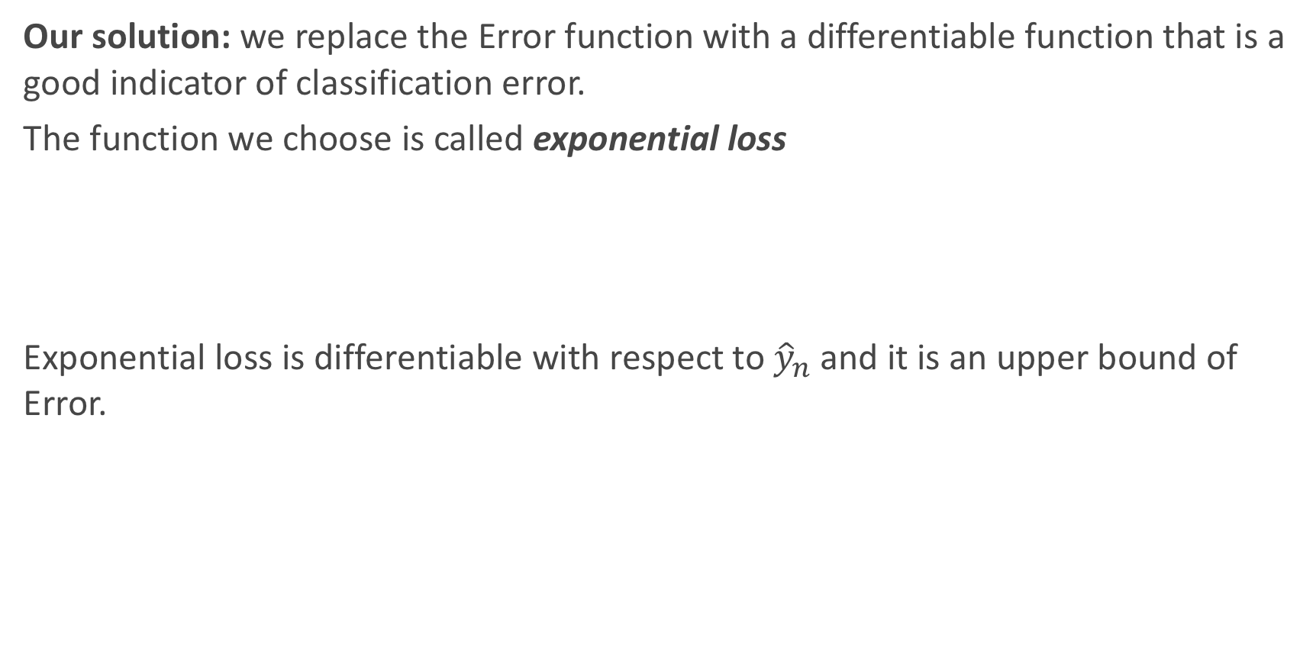
Motivation for AdaBoost (cont.)
Our solution: we replace the Error function with a differentiable function that is a good indicator of classification error.
The function we choose is called exponential loss
Exponential loss is differentiable with respect to ${\hat{y}}_{n}$and it is an upper bound of Error.

Slide 53
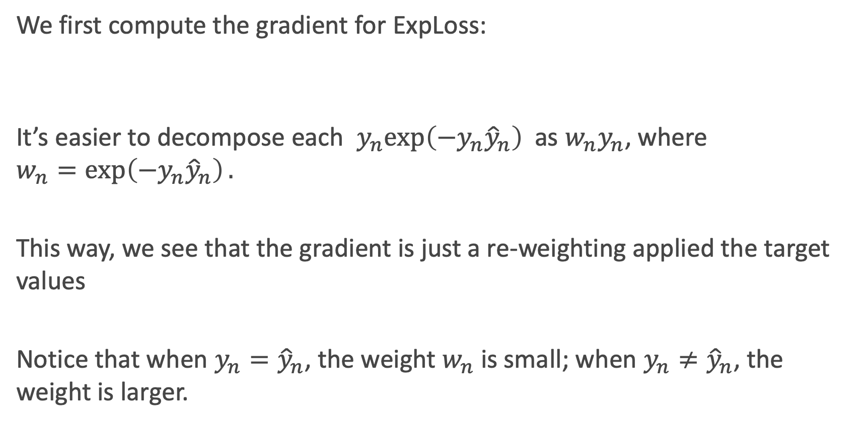
Gradient Descent with Exponential Loss
We first compute the gradient for ExpLoss:
It’s easier to decompose each $y_{n}exp\left(−y_{n}{\hat{y}}_{n}\right)$as ${w_{n}y}_{n}$, where $$w_{n}=\exp\left(−y_{n}{\hat{y}}_{n}\right).$$
This way, we see that the gradient is just a re-weighting applied the target values
Notice that when $y_{n}={\hat{y}}_{n}$, the weight $w_{n}$ is small; when $y_{n}≠{\hat{y}}_{n}$, the weight is larger.

Slide 54
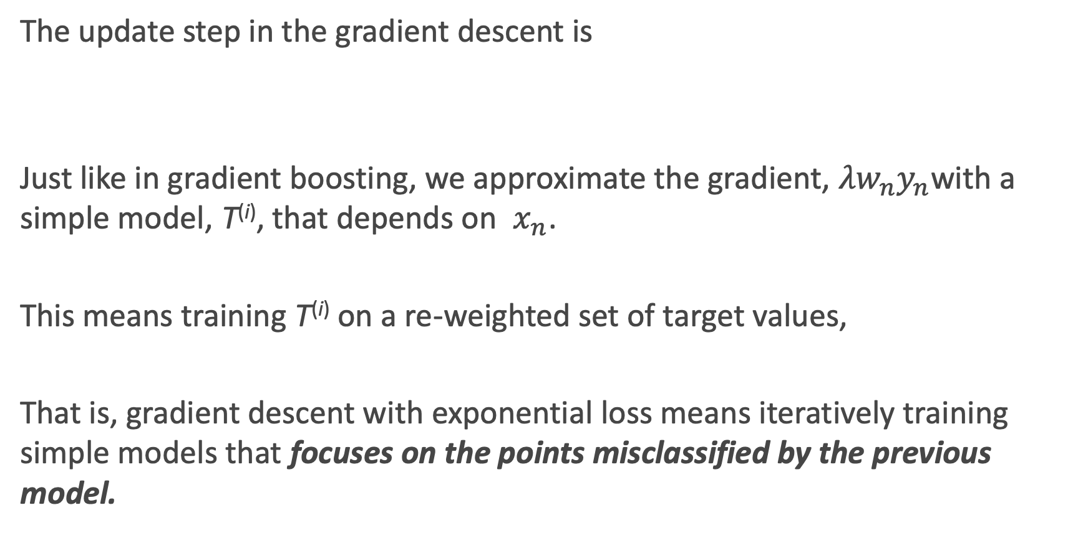
Gradient Descent with Exponential Loss
The update step in the gradient descent is
Just like in gradient boosting, we approximate the gradient, ${{λw}_{n}y}_{n}$with a simple model, T^{(i)}, that depends on $x_{n}$.
This means training T^{(i)} on a re-weighted set of target values,
That is, gradient descent with exponential loss means iteratively training simple models that focuses on the points misclassified by the previous model.

Slide 55
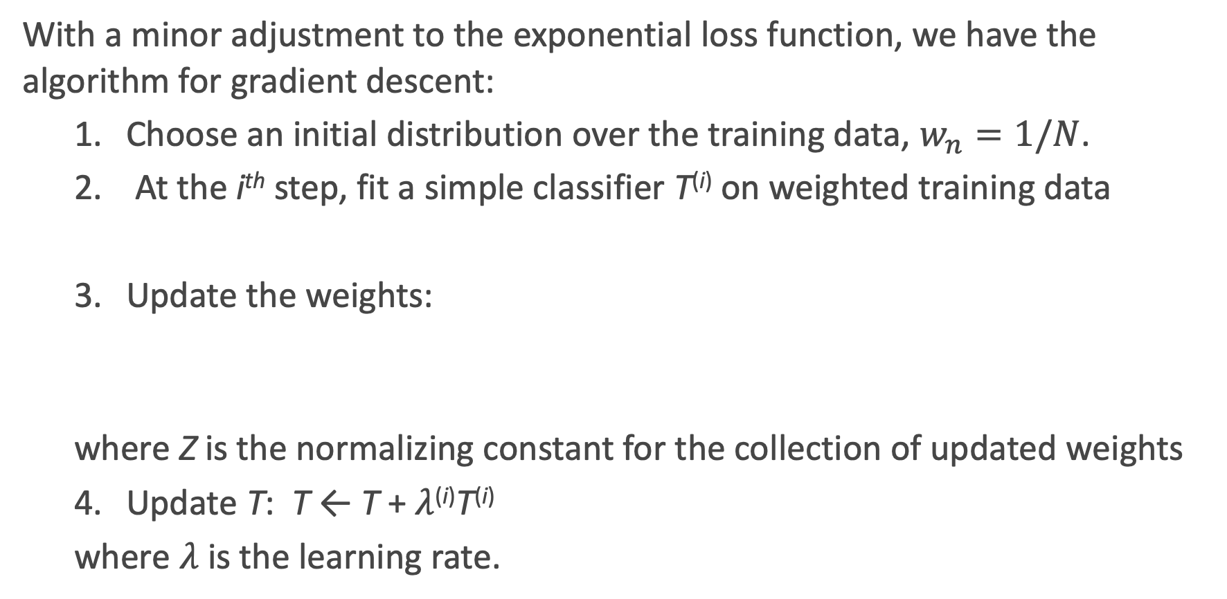
AdaBoost
With a minor adjustment to the exponential loss function, we have the algorithm for gradient descent:
1. Choose an initial distribution over the training data, $w_{n}=1/N$.
2. At the i^{th} step, fit a simple classifier T^{(i)} on weighted training data
3. Update the weights:
where Z is the normalizing constant for the collection of updated weights
4. Update T: T ← T + $λ$^{(i)}T^{(i)}
where $λ$ is the learning rate.

Slide 56
Choosing the Learning Rage
Unlike in the case of gradient boosting for regression, we can analytically solve for the optimal learning rate for AdaBoost, by optimizing:
Doing so, we get that

Slide 57
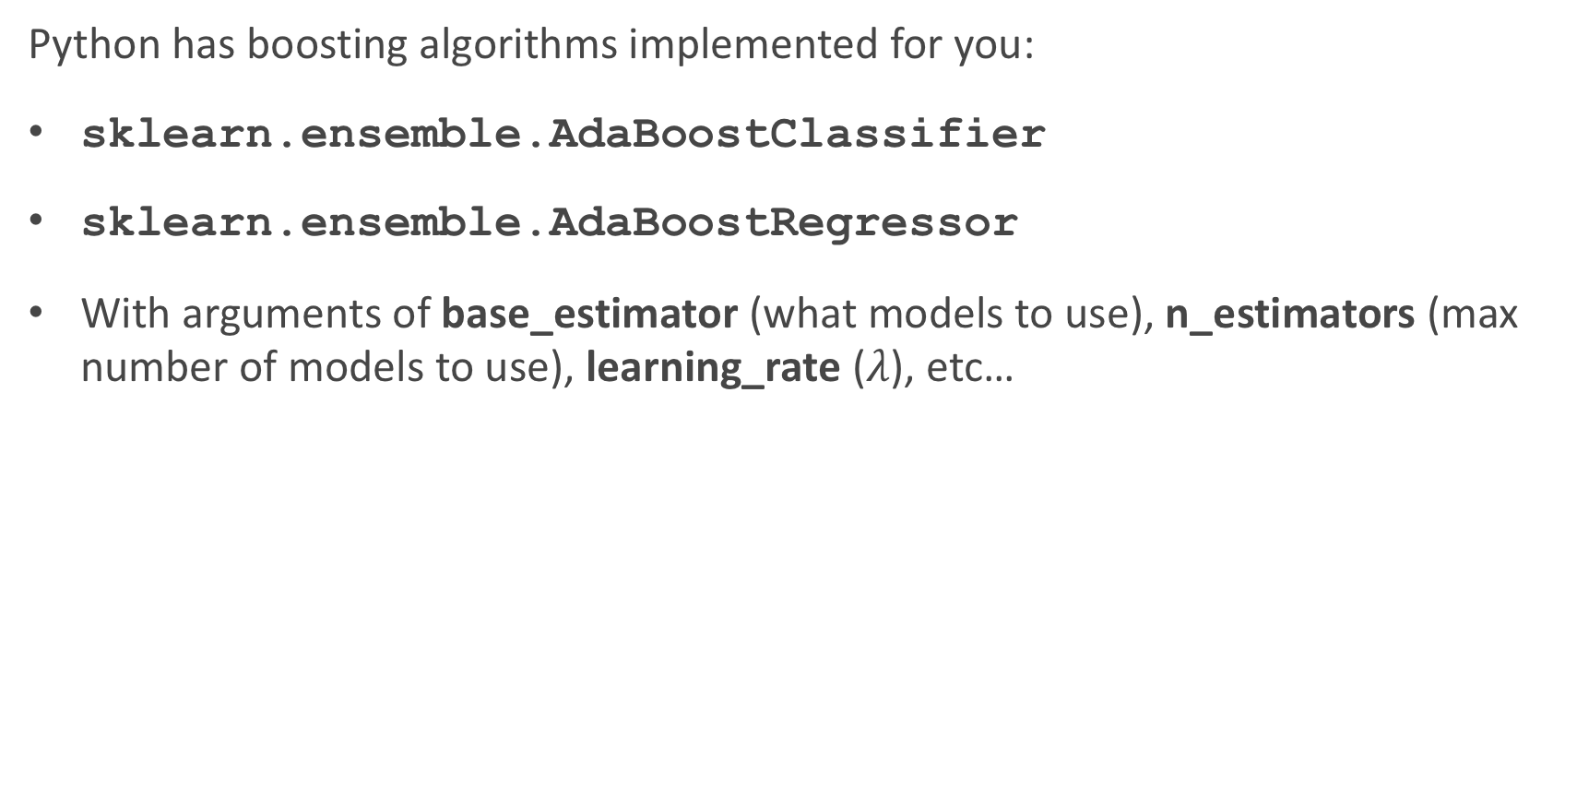
Boosting in sklearn
Python has boosting algorithms implemented for you:
sklearn.ensemble.AdaBoostClassifier
sklearn.ensemble.AdaBoostRegressor
With arguments of base_estimator (what models to use), n_estimators (max number of models to use), learning_rate ($λ$), etc…

Slide 58
Stacking

Slide 59
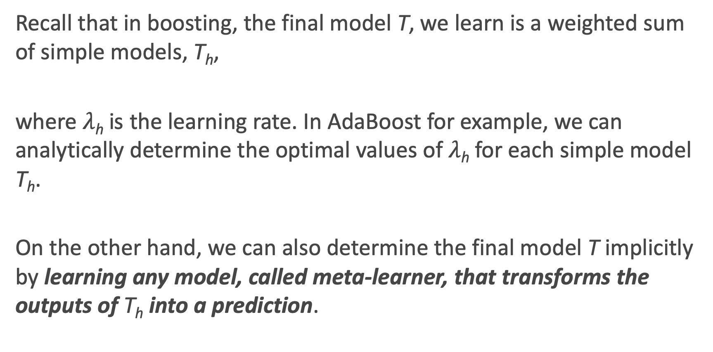
Motivation for Stacking
Recall that in boosting, the final model T, we learn is a weighted sum of simple models, T_{h},
where $λ$_{h} is the learning rate. In AdaBoost for example, we can analytically determine the optimal values of $λ$_{h} for each simple model T_{h}.
On the other hand, we can also determine the final model T implicitly by learning any model, called meta-learner, that transforms the outputs of T_{h} into a prediction.

Slide 60
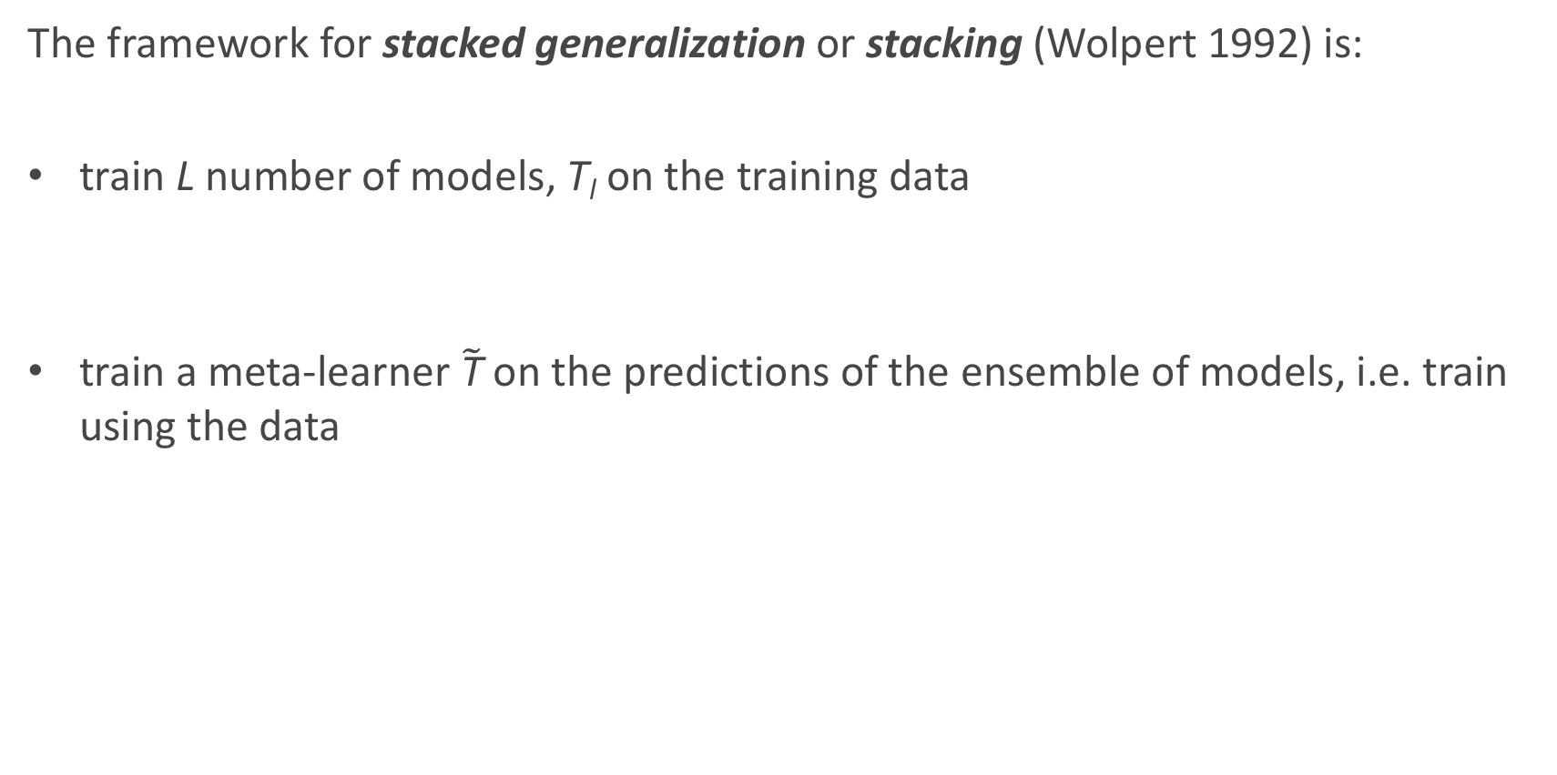
Stacked Generalization
The framework for stacked generalization or stacking (Wolpert 1992) is:
train L number of models, T_{l} on the training data
train a meta-learner $\tilde{\text{T}}$ on the predictions of the ensemble of models, i.e. train using the data

Slide 61
Stacking: an Illustration

Slide 62
Stacking: General Guidelines
The flexibility of stacking makes it widely applicable but difficult to analyze theoretically. Some general rules have been found through empirical studies:
models in the ensemble should be diverse, i.e. their errors should not be correlated
for binary classification, each model in the ensemble should have error rate < 1/2
if models in the ensemble outputs probabilities, it’s better to train the meta-learner on probabilities rather than predictions
apply regularization to the meta-learner to avoid overfitting

Slide 63
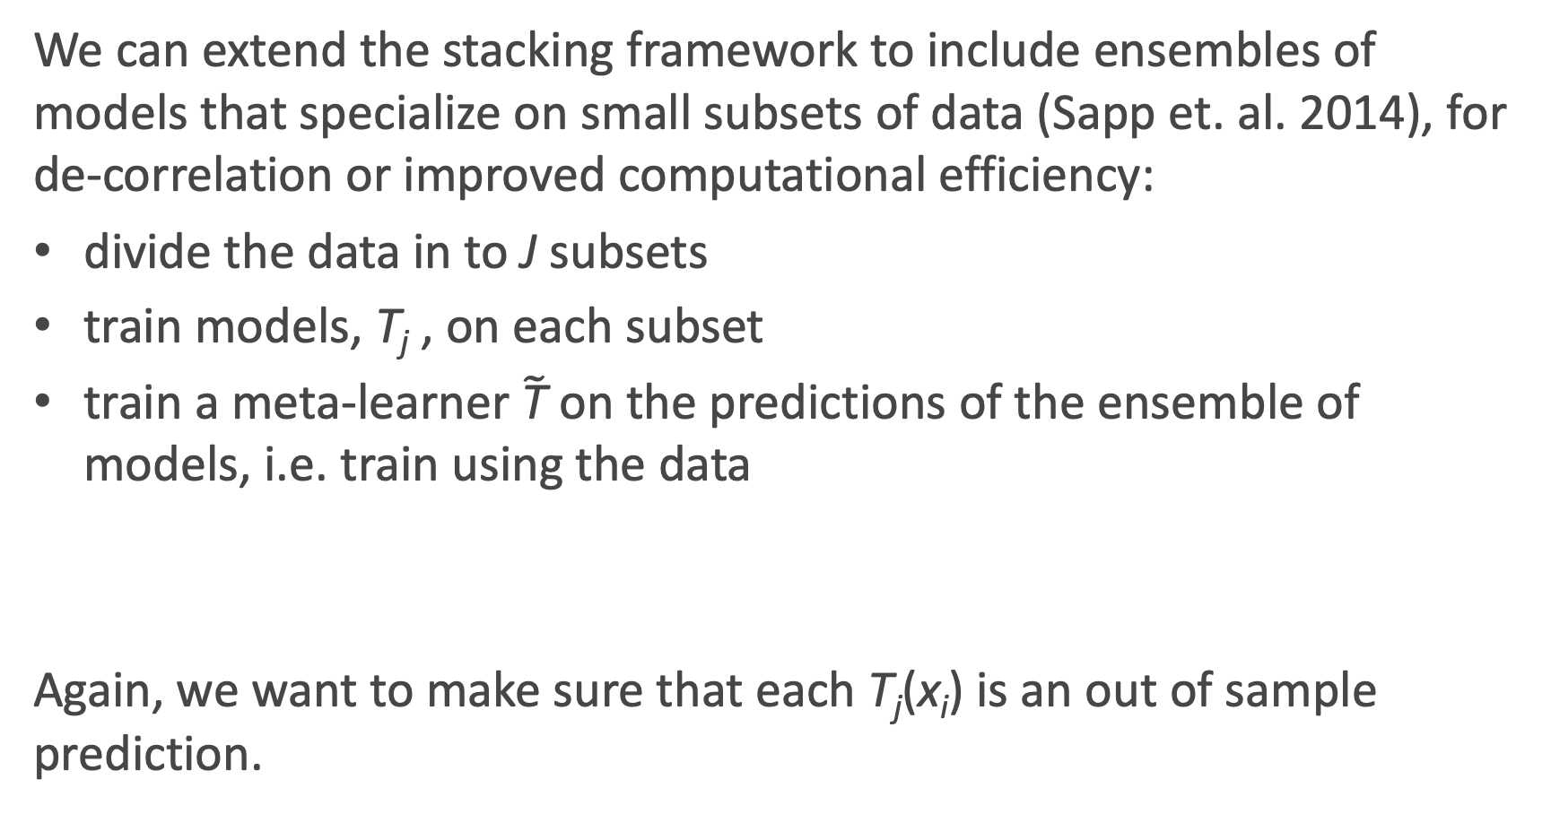
Stacking: Subsemble Approach
We can extend the stacking framework to include ensembles of models that specialize on small subsets of data (Sapp et. al. 2014), for de-correlation or improved computational efficiency:
divide the data in to J subsets
train models, T_{j} , on each subset
train a meta-learner $\tilde{\text{T}}$ on the predictions of the ensemble of models, i.e. train using the data
Again, we want to make sure that each T_{j}(x_{i}) is an out of sample prediction.

Slide 64
Stacking in sklearn
Unfortunately, Python does not have stacking algorithms implemented for you ☹
So how can we do it?
We can set it up by ‘manually’ fitting several base models, take the outputs of those models, and fitting the meta model on the outputs of those base models.
It’s a model on models!

